Slide 1

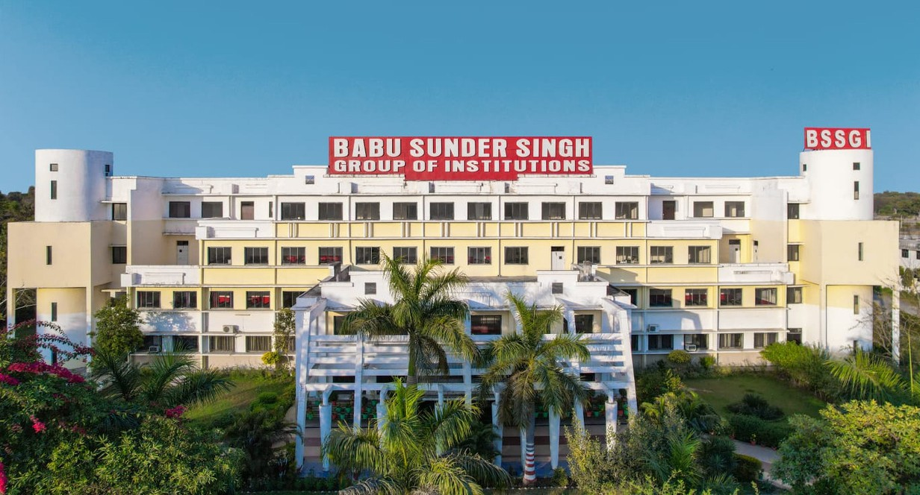
BABU SUNDER SINGH GROUP OF INSTITUTIONS
INFORMATION BROCHURE
DEPARTMENT OF CIVIL ENGINEERING

Slide 2

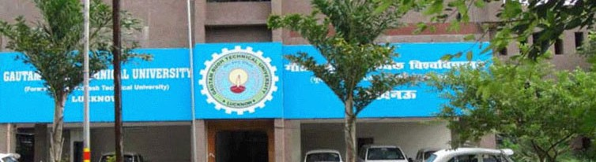



We are....
Babu Sunder Singh Institute of Technology & Management, Lucknow
Ap proved by
Affiliated To
AKTU ( Dr. A.P.J. Abdul Kalam Technical University, Luckow)
AICTE (ALL INDIA COUNCIL OF TECHNICAL EDUCATION)
Uttar Pradesh Board of Technical Education Lucknow

Slide 3
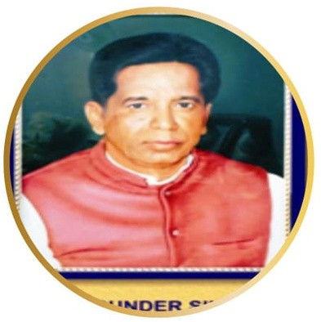
Our Inspiration
[ Late. Shri Babu Sunder Singh Ji ]
Our efforts in the laying foundation of “Babu Sunder Singh Institute of Technology and Management” is a continuation of his dream and vision

Slide 4
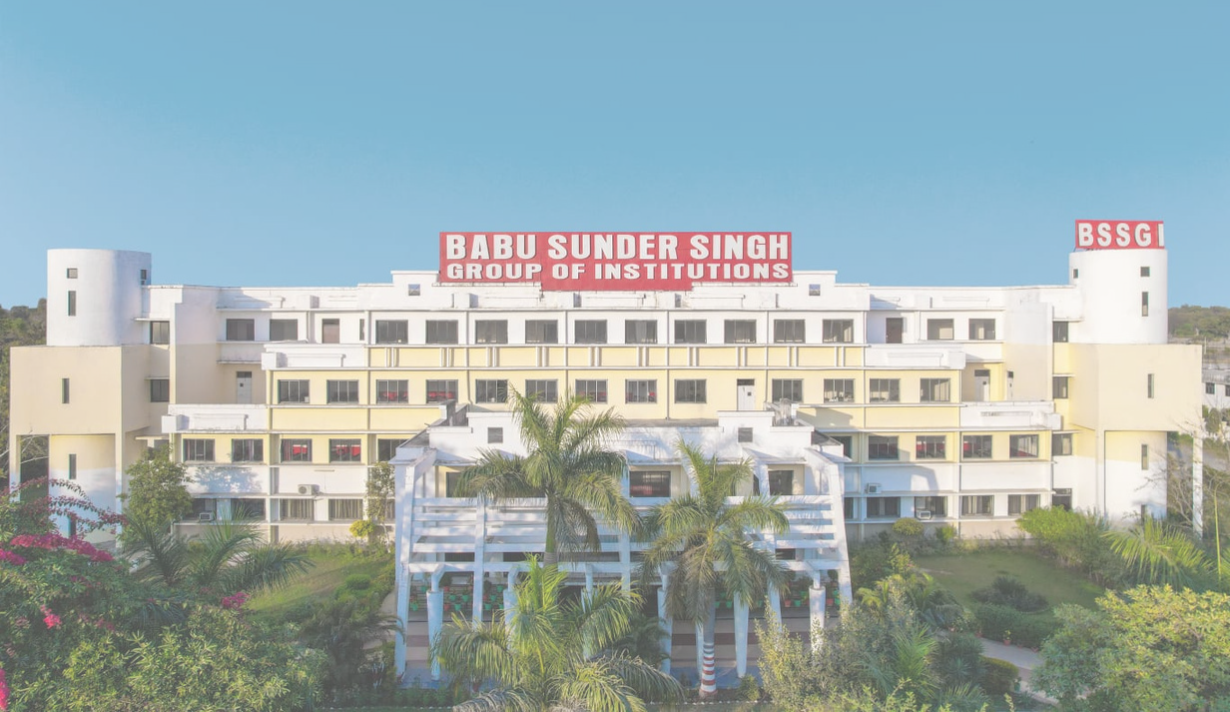
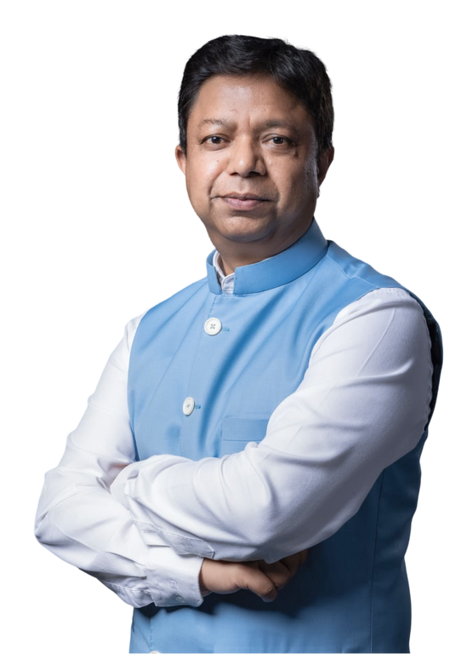
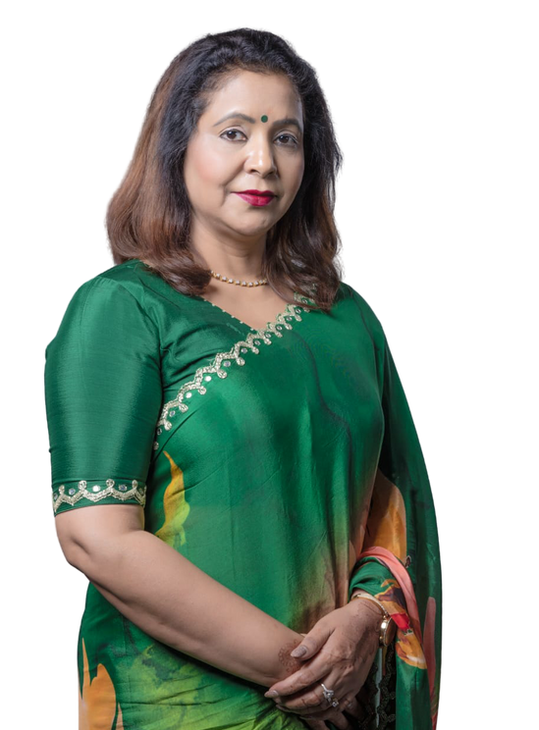
The Founders
Mrs. Rina Singh
Er. Anand Shekhar
Singh
(Chairperson)
(Chairman )

Slide 5
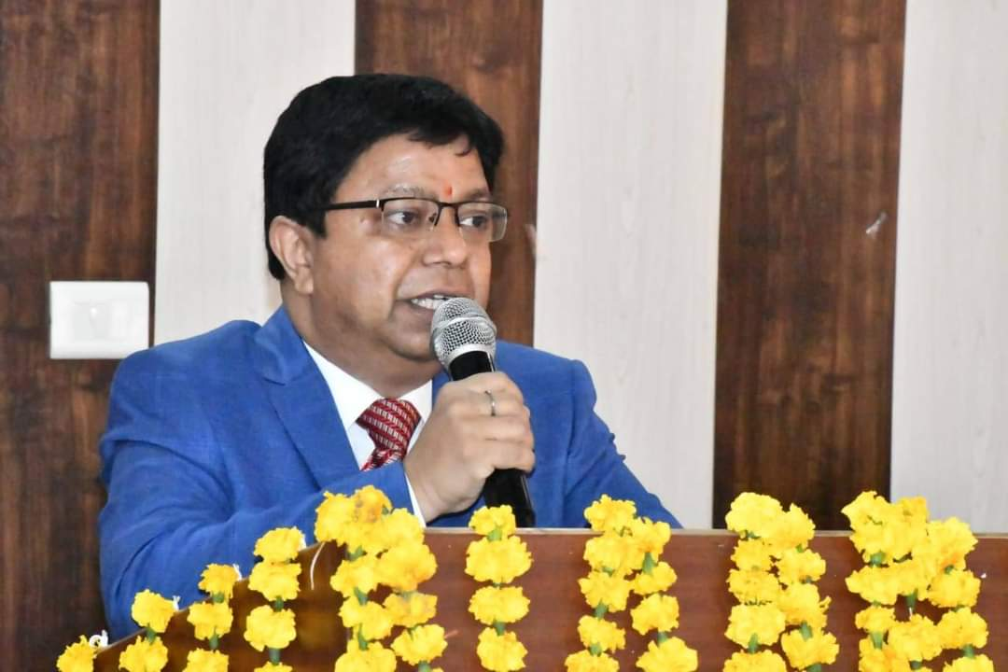
The Chairman’s Message
Er. Anand Shekhar Singh has completed his Education from The State Mining University, Moscow(Russia) with B.Tech & M.Tech Degree in Mechanical Engineering and MBA from Russian Academy of Economics. He grew up watching his father very closely and was very influenced by him. Through the Institute his aim to provide quality education as per international standards without making any compromises in terms of faculty, labs, infrastructures or facilities.
He is sure all those who become a part of the BSSGI will enrich their lives as we strongly believe in wisdom, innovation and excellence & yes, it is the reputation which one builds and that is what actually matters.
Regards & Best wishes,
Er. Anand Shekhar Singh,
Chairman BSSGI

Slide 6
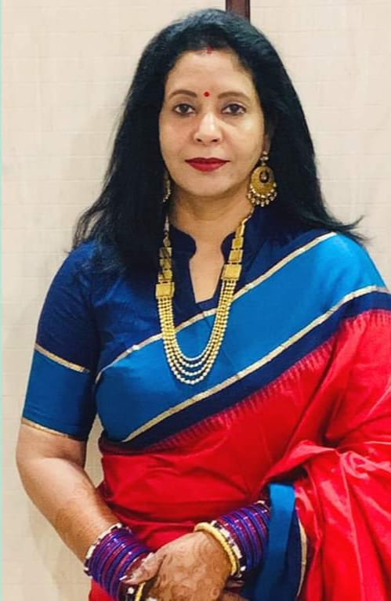
The Chairperson’s Message
It is indeed a great pleasure in welcoming you to Babu Sunder Singh Institute of Technology and Management and Babu Sunder Singh College of Pharmacy under the aegis of Babu Sunder Group of Institutions (BSSGI). The past years of performance of the colleges under BSSGI have been a fulfilling experience but not that of complacence. We endeavour to strive further and surge ahead in providing quality and competitive education through state-of-the-art technology and infrastructure in the contemporary Knowledge Society. The last years were just few steps in our constant march towards reaching new horizons and touching new skies in the tough and competitive technical and management education, and at the same time not compromising with human values nurtured in our society.
Regards & Best wishes,
Mrs. Rina Singh,
Chairperson BSSGI

Slide 7
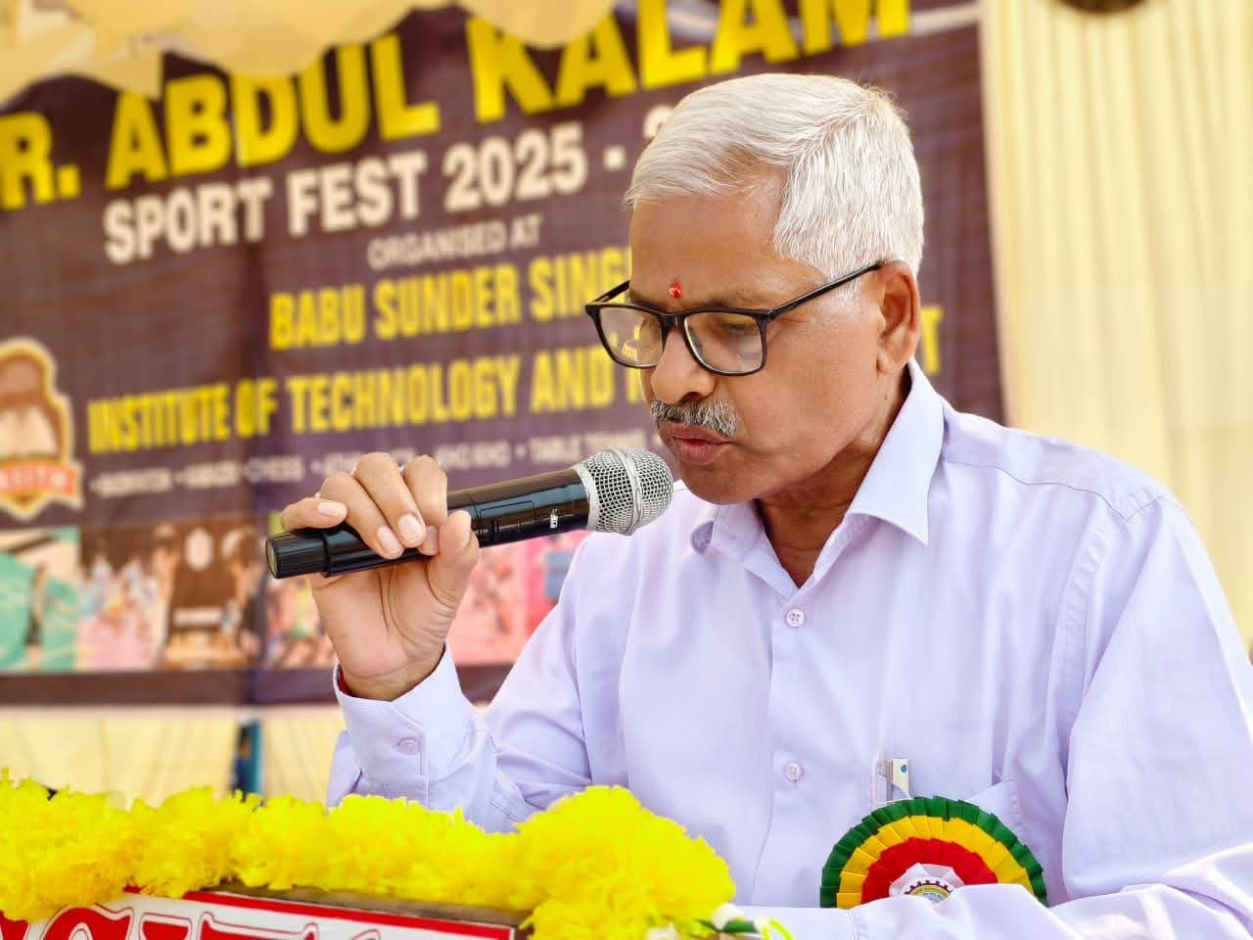
Director General’s Message
To the builders of tomorrow, Civil engineering is a unique calling. Our greatest success is often invisible: when a bridge stands firm or water flows clean, society moves forward without a second thought. We are the silent guardians of the public trust.
As you master the math and mechanics, remember that you aren't just calculating loads—you are protecting lives. In an era of climate change and rapid urbanization, the world needs more than technicians; it needs visionaries who build for resilience and legacy.
The weight of the future rests on your shoulders. Study with the gravity that responsibility demands, and build with the integrity that generations deserve.
Your work is the foundation upon which the world stands. Build it well.
Regards & Best wishes,
Dr. Karunakar Singh
Director General,
BSSGI

Slide 8
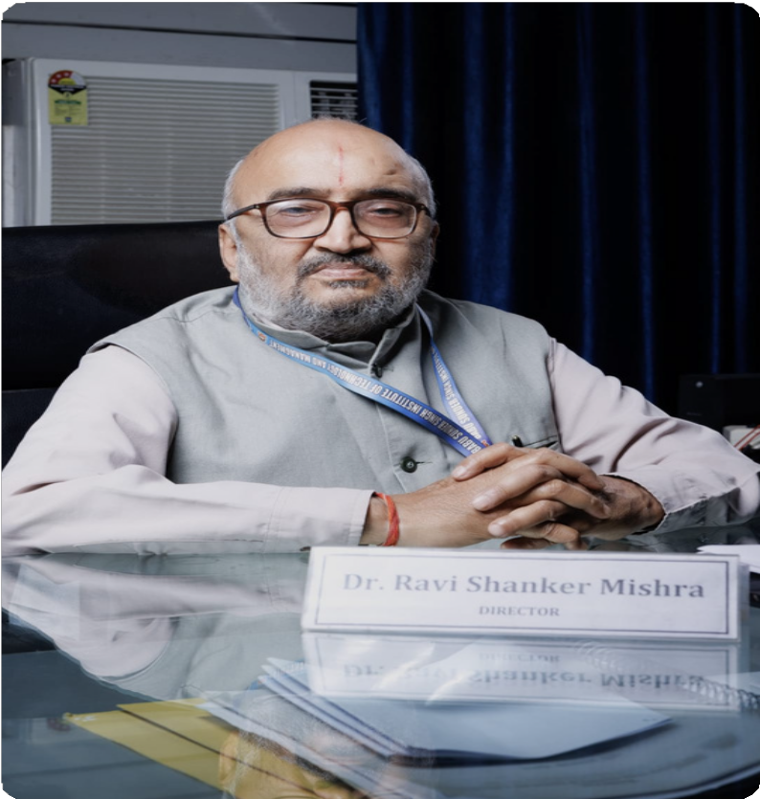
Director’s Message
As we all are fast forwarding towards the technologies and immense learning, a good guidance and counselor is always been a need for the proper path selection. , We at Babu Sunder Singh institute of technology and management (BSSITM) assure to embed the technical, professional, philosophical and moral values in our students. With all round development strategy and technical outcome based learning programs we make the students - Industry Ready.
Our eminent and professional faculty with the help of - advanced labs, live industry projects, expert lectures, remedial classes and other sequential grooming elements put effective efforts to make the students future potentially strong and secure.
BSSITM approaches and encourages the detoriated students by enhancing the innovative and modern Design thinking via Co-curricular activities on regular basis.
Regards & Best wishes,
Dr. Ravi Shanker Mishra
Director
Babu Sunder Singh Institute of Technology and Management

Slide 9
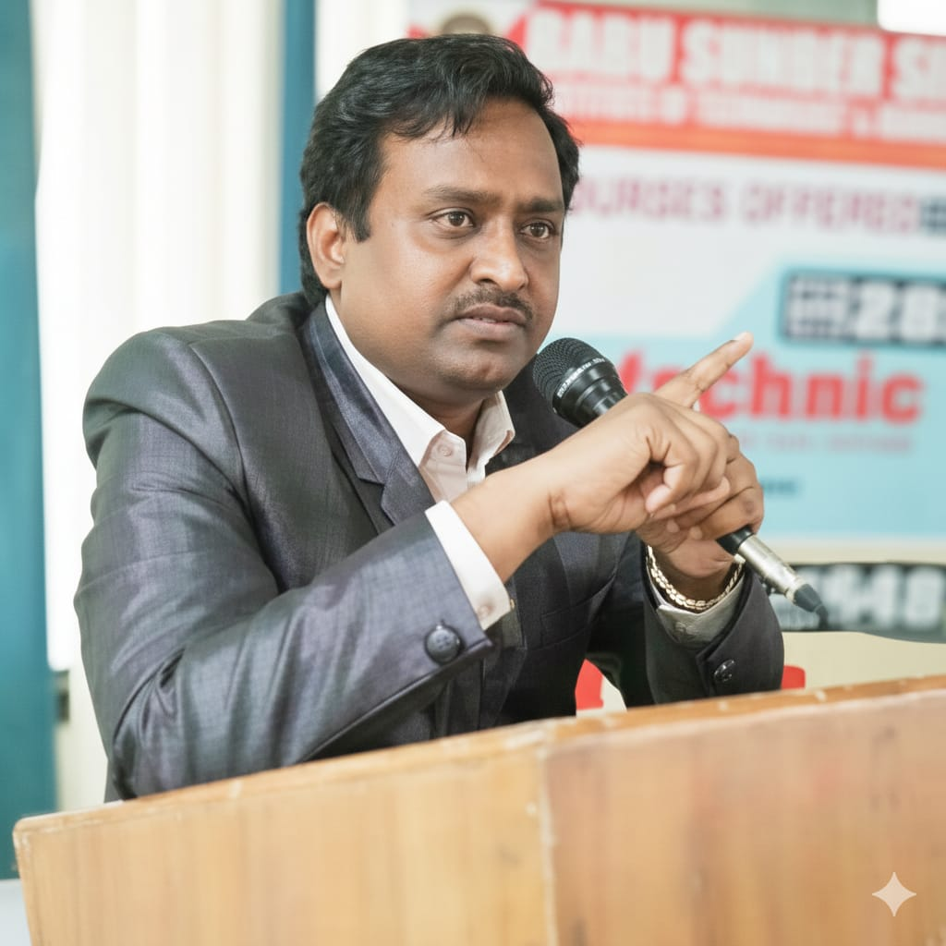
Dean Academic’s Message
Education is the most critical infrastructure we will ever build. As your Dean, my mission is to ensure that your time here is more than just a path to a degree—it is a rigorous preparation for a world that demands both technical mastery and ethical courage.
Our curriculum is designed to challenge your assumptions and sharpen your problem-solving abilities. In these halls, we don’t just teach you how things work; we challenge you to imagine how they can work better, more sustainably, and more inclusively.
To our students: Approach your studies with the same precision you would a skyscraper. The habits, integrity, and curiosity you develop today are the foundation of your professional legacy. We provide the tools; you provide the ambition.
Let us build a future defined by excellence, one lesson at a time.
Regards & Best wishes,
Dr. Amit Kumar Srivastava
Dean Academics
Babu Sunder Singh Institute of Technology and Management

Slide 10
THE VISION & MISSION OF THE INSTITUTE
Vision of the Institute
To evolve into distinguished institution that nurtures a vibrant learning atmosphere, empowering aspiring engineers to emerge as ethical technology leaders and entrepreneurs for societal wellbeing and national advancement through innovation and research.
Mission of the Institute
M1- To bridge the gap between theory and practice through effective teaching learning process and hands on experiments.
M2 - To cultivate creative minds by indulging them in innovative projects and research. M3- To foster a culture that promotes entrepreneurial risk taking and adaptability.
M4- To create technological leaders by inculcating moral values for societal welfare and lifelong learning.

Slide 11
THE VISION & MISSION OF THE
DEPARTMENT
Vision of the Department
To excel by creating responsible, technically innovative qualified professional leader with ethical entrepreneurship and social values in the field of Civil Engineering.
Mission of the Department
M1:- To provide excellence in teaching and learning with emphasis on hands on experience.
M2:- To produce competent and capable civil engineering professionals through industry academic stimulus.
M3:- To inculcate team sprit & leadership capabilities among graduates through group-based activities and projects.
M4:- To mould civil engineering student as dignified and responsible citizens with ethical entrepreneurship and social values.

Slide 12
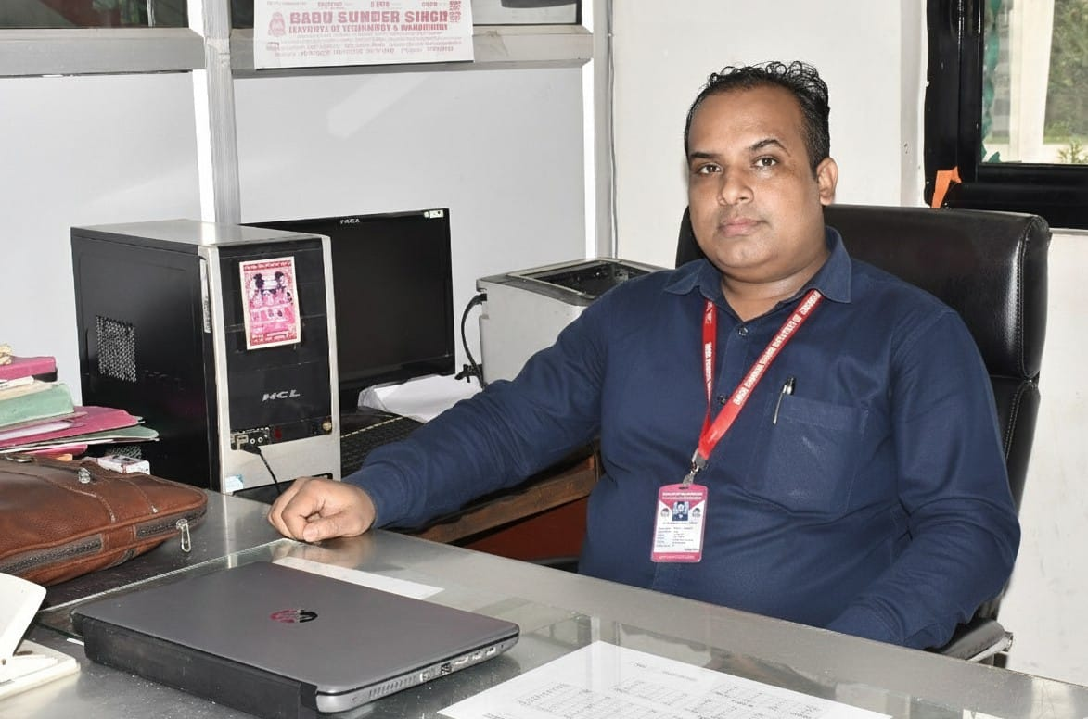
DSW/HOD’s Message
Civil Engineering is a broad field of engineering that comprises planning, construction, maintenance, and management of fixed structures or public works related to earth, water, or railways and their processes.
Civil Engineering deals with the Construction and Maintenance of Buildings, Bridges, Roads, Railways, Structures, Water Supply & Sewer, Irrigation, Power & Environment. Students will learn about flood control, Alternate Building Materials, Green Buildings, Structural Health Monitoring, Transportation Engineering, etc. The department also provides students the opportunity to improve communication and presentation skills, knowledge of software like Auto CAD, STAAD PRO, E-TABS, Arc GIS, Rivet Architecture, Microsoft Project Management (MSP), and Primavera. The student undergoes Industrial Training and visits live construction sites to gain practical knowledge and understanding of the field constraints.
The Civil Department has well-qualified and experienced teaching faculty who are enthusiastic about providing students with quality instruction. The primary goal is to instill subject fundamentals through animation, video clips, projects, field surveys, and case studies. It has well-equipped laboratories, computational facilities, and modern classrooms, as well as a conducive learning environment.
Er. VISHWAJEET YADAV
HEAD OF DEPARTMENT

Slide 13
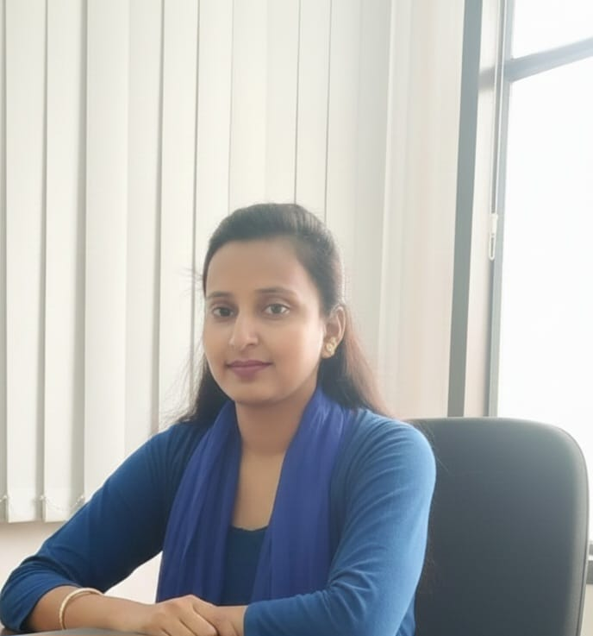
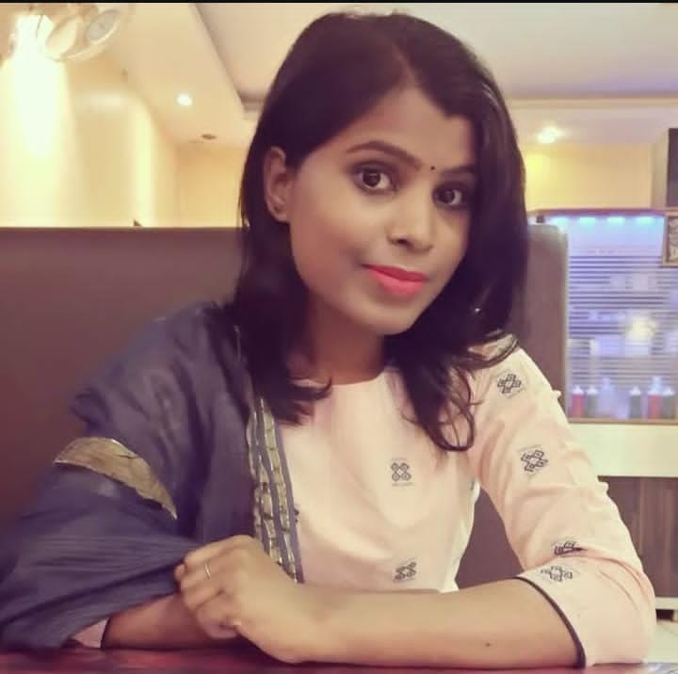
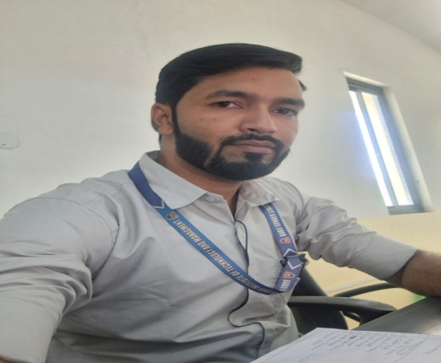
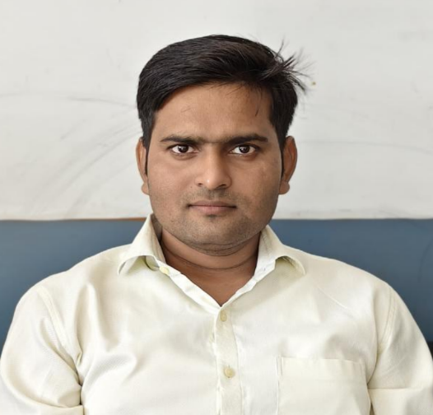
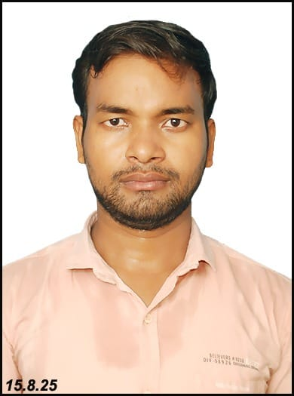
Our Faculty Experts:-
Er. Astha Singh
Assistant Professor
Experience- 8 years
Er. Raj Kumar Singh
Assistant Professor
Experience- 8 years
Er. Nazima Ansari
Assistant Professor
Experience- 8 years
Er. Pradeep Kumar Yadav
Assistant Professor
Experience- 8 years
Mr. Ashish Kumar
Lecturer
Experience- 7 years

Slide 14
ACADEMIC PROGRAMS
Diploma (3 years)- Civil Engineering Intake-30
A Diploma in Civil Engineering is a course focusing on the practical aspects of planning, designing, constructing, and maintaining structures like buildings, roads, bridges, and other infrastructure.
B.Tech (4 years)- Civil Engineering Intake-60
Major and minor system of education: Civil Engineering will be the subject and student can select a minor subject from the other department .
Why Civil Engineering ?
- Civil engineering is the oldest and perhaps the most popular branch of engineering. It is continuing for thousands of years and will remain in practice for any more millenniums.
- Civil engineering is based on mature and safe technology; therefore, the techniques taught in the four-years B.Tech program will be relevant for many more years to practice in real life.
- Civil engineering offers a wide range of job opportunities, including Core industry, Government & PSU, IT industries, academics, R&D and entrepreneurship. Civil engineering jobs are usually challenging and adventurous.
- Opportunity for civil engineering is available throughout the globe, starting from city to forest and stretches from land to sea.

Slide 15
WHAT DO CIVIL ENGINEERS DO?
- Investigate, design and manage the Construction Activities.
- Interpret and organize drawings, plans, construction methods and procedures.
- Provide smart mobility solutions.
- Design a roads, bridges, runways and Manage its construction.
- Develop ways of treating and reusing Storm water and waste water to preserve precious resources.
- Develop mathematical or physical models of systems, such as soils, traffic flows, to study behaviour and develop better management approaches for systems.
- Test the soil characteristics parameters for the best suited foundation design.
- Act as a solution finder for all kinds of building problems.
- Contribute innovative skills in Research and Development for the inventive exploring of Building material or technology.
-Work in public and private sector organization in all types of construction works.

Slide 16
Why at BSSITM ?
Academic
- Syllabus designed in accordance with latest need of industries. Choice based learning system.
- State of the art laboratory facilities along with Modern computational facilities.
- Highly qualified faculty members. Major and minor system of education.
Placement
- Provides ample opportunity for campus placement in core industries. Plenty of opportunity for students interested in IT industries. Rigorous pre-placement training for both core and IT industries. Graduate talent development program (GTDP).
-- Skill enhancement through workshop, international conferences, HR conclave and Industry knowledge lecture series, etc.
Value Addition Learning
- Summer internship programs. Encouragement for research.
- Exposer to the Multi-dimensional Consultancy Projects. Unique industry – academia partnerships.
- Student exchange program.
Outreach Activities
- Involvement of students in Societal Research Projects. -
- NSS societies are actively involved in various extension and outreach activities.
- The societies and chapters encourage students to participate and organize different techno-cultural events and competitions.

Slide 17
Academic Laboratories
- Geotechnical Engineering Lab
- Structural Engineering Lab
- Environmental Engineering Lab
- Concrete & Material Testing Lab
- Transportation Engineering Lab
- Fluid Mechanics Lab
- Hydraulics & Hydraulics Machine Lab
- Surveying Lab
- Engineering Graphics Lab
- Masonry Demonstration Lab

Slide 18
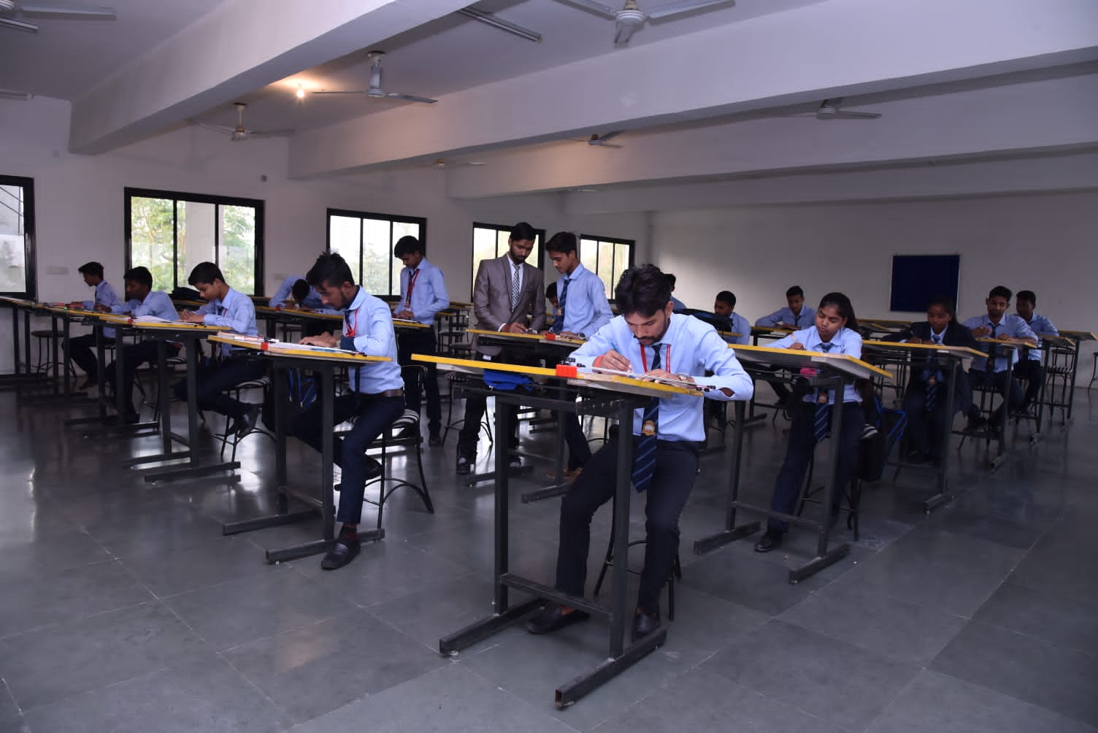
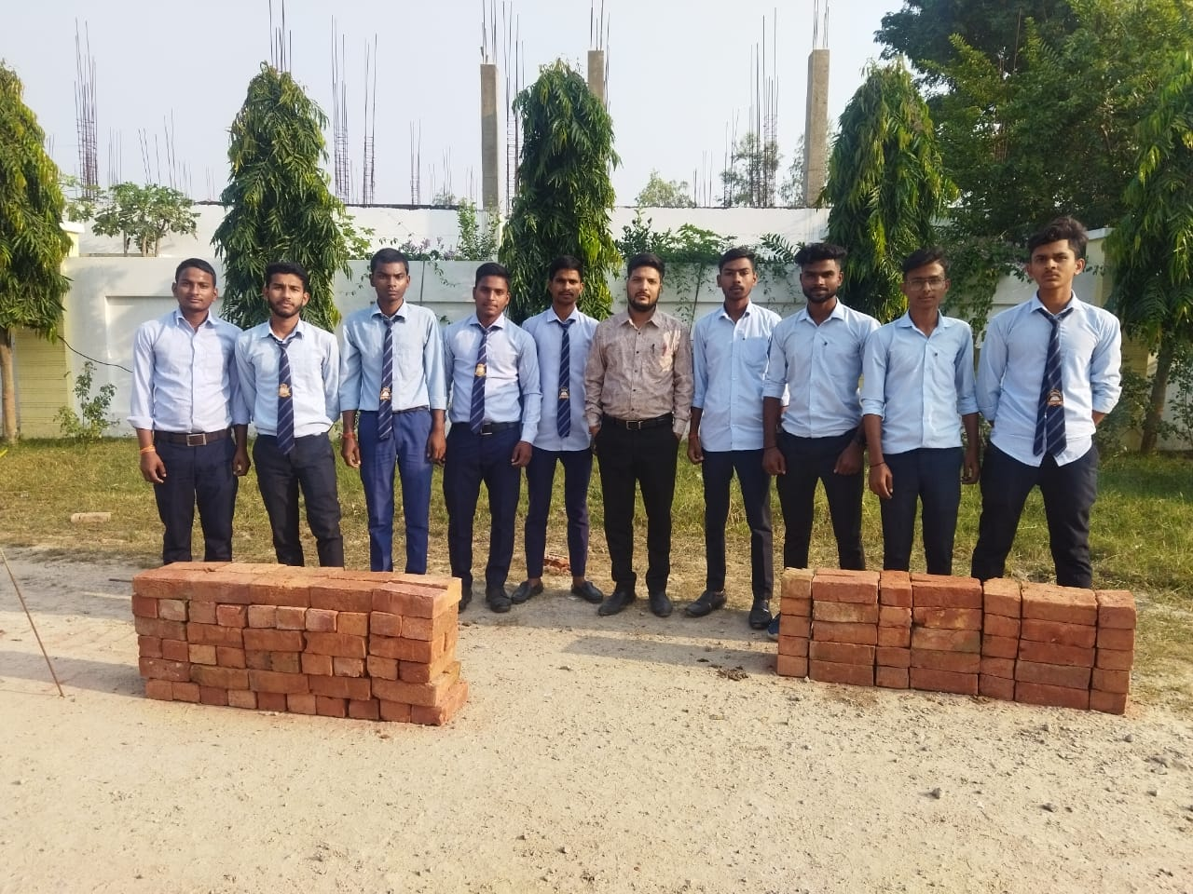
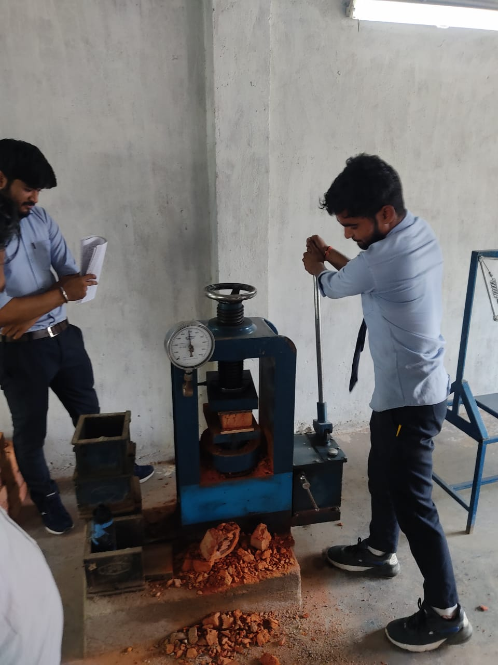
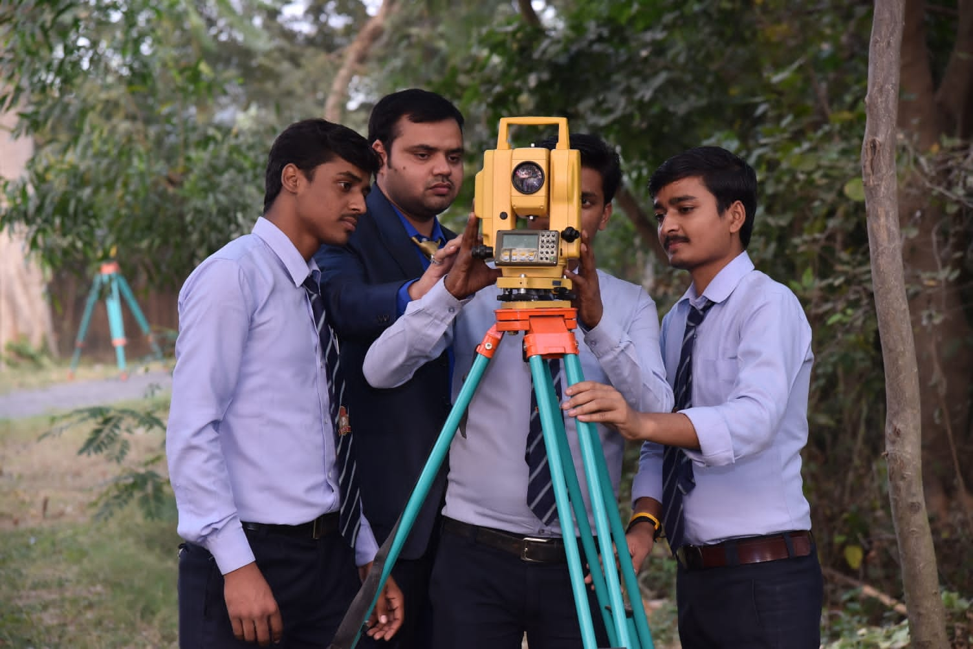
STUDENTS ACTIVITIES (Curricular)
LAB ACTIVITIES

Slide 19
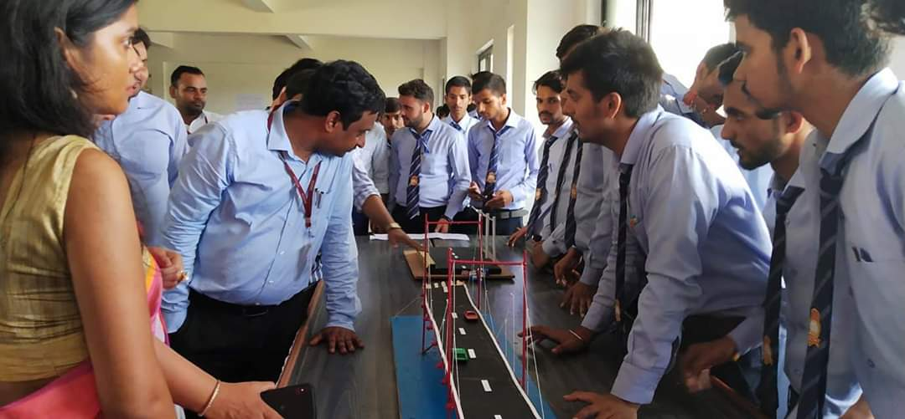
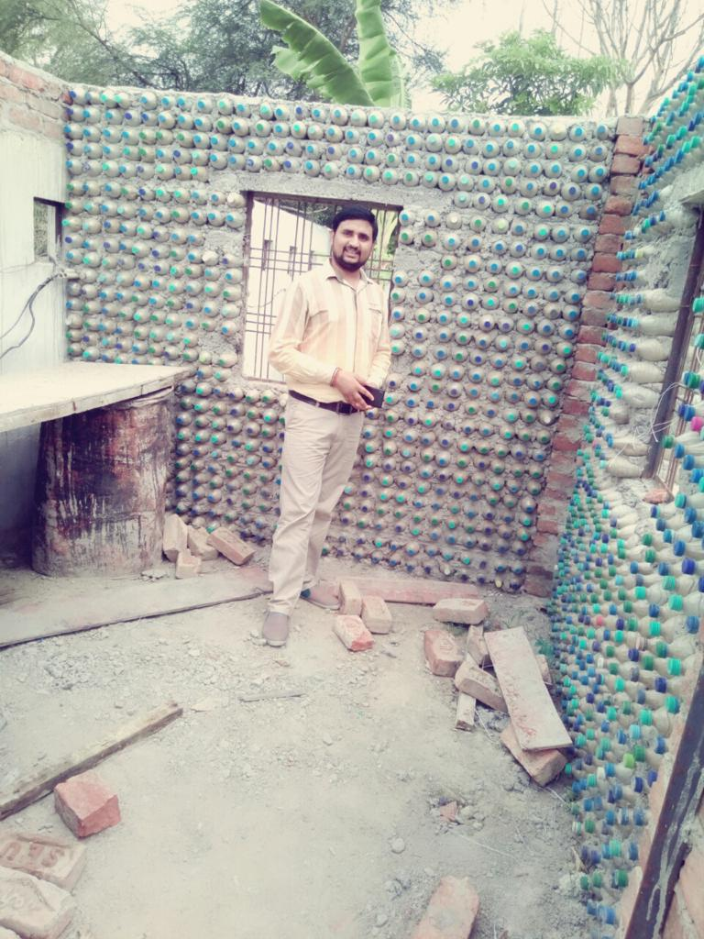
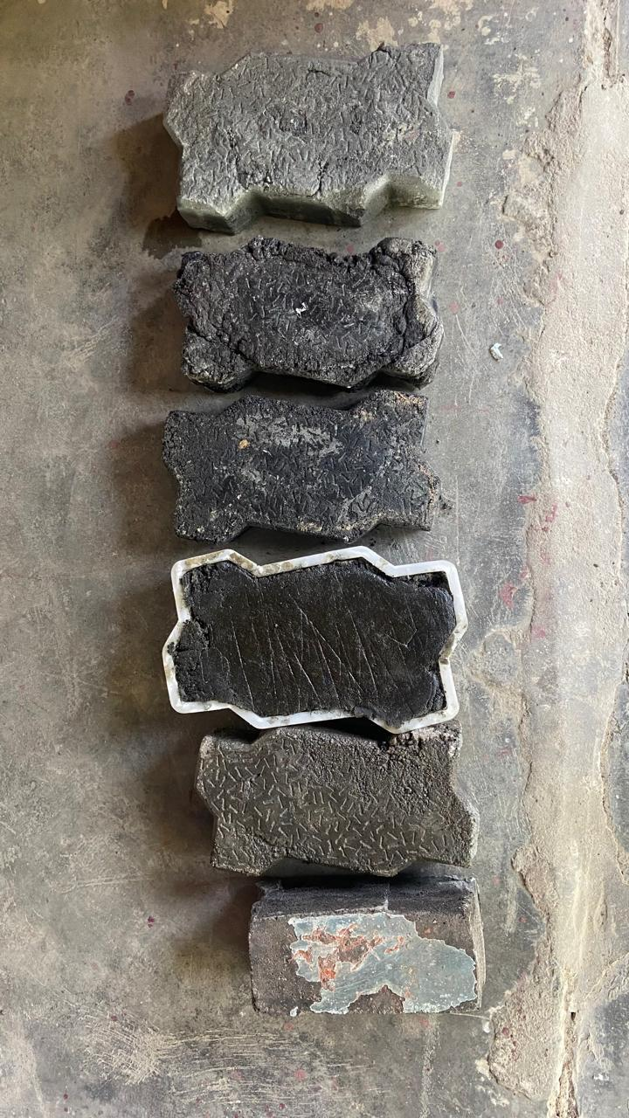
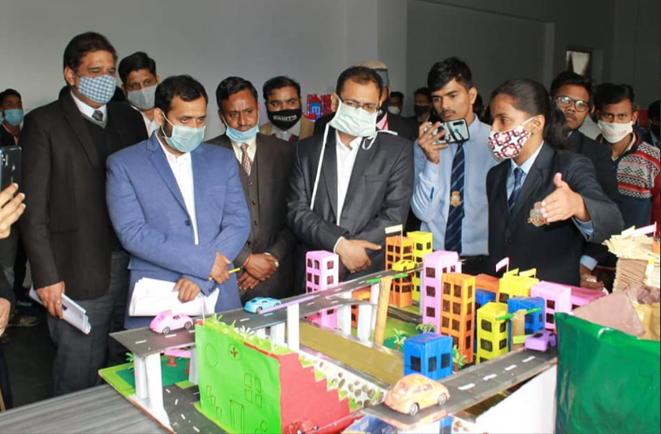
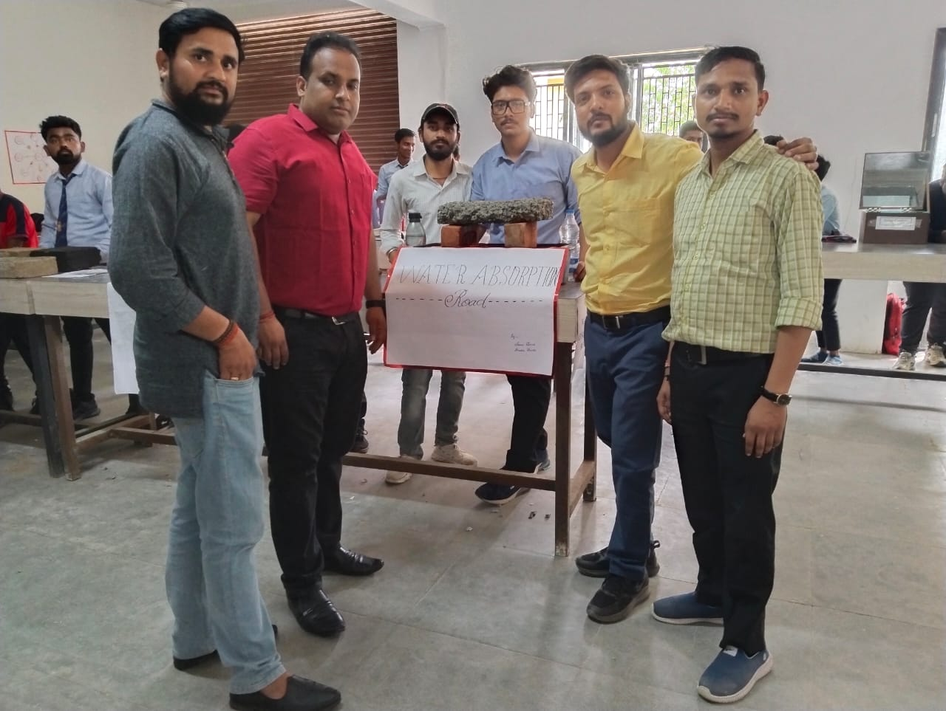
STUDENTS ACTIVITIES (Curricular)
Project & model presentation

Slide 20
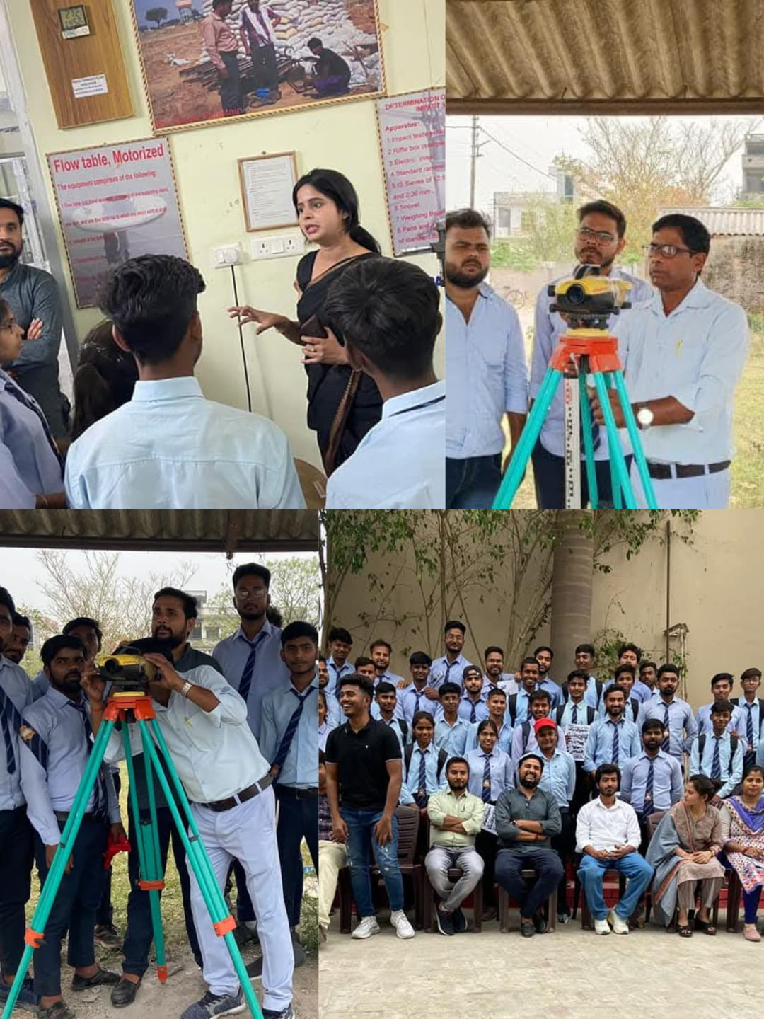
Industrial Visits

Slide 21
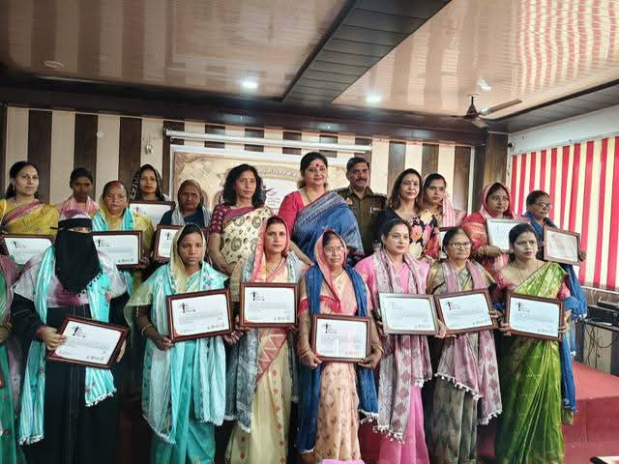
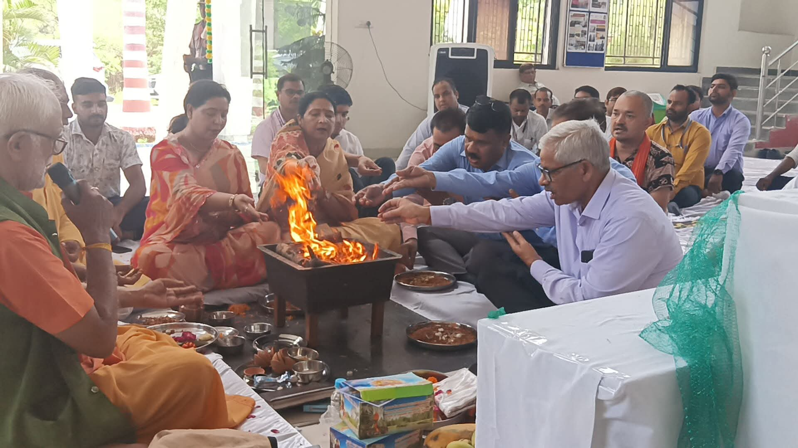
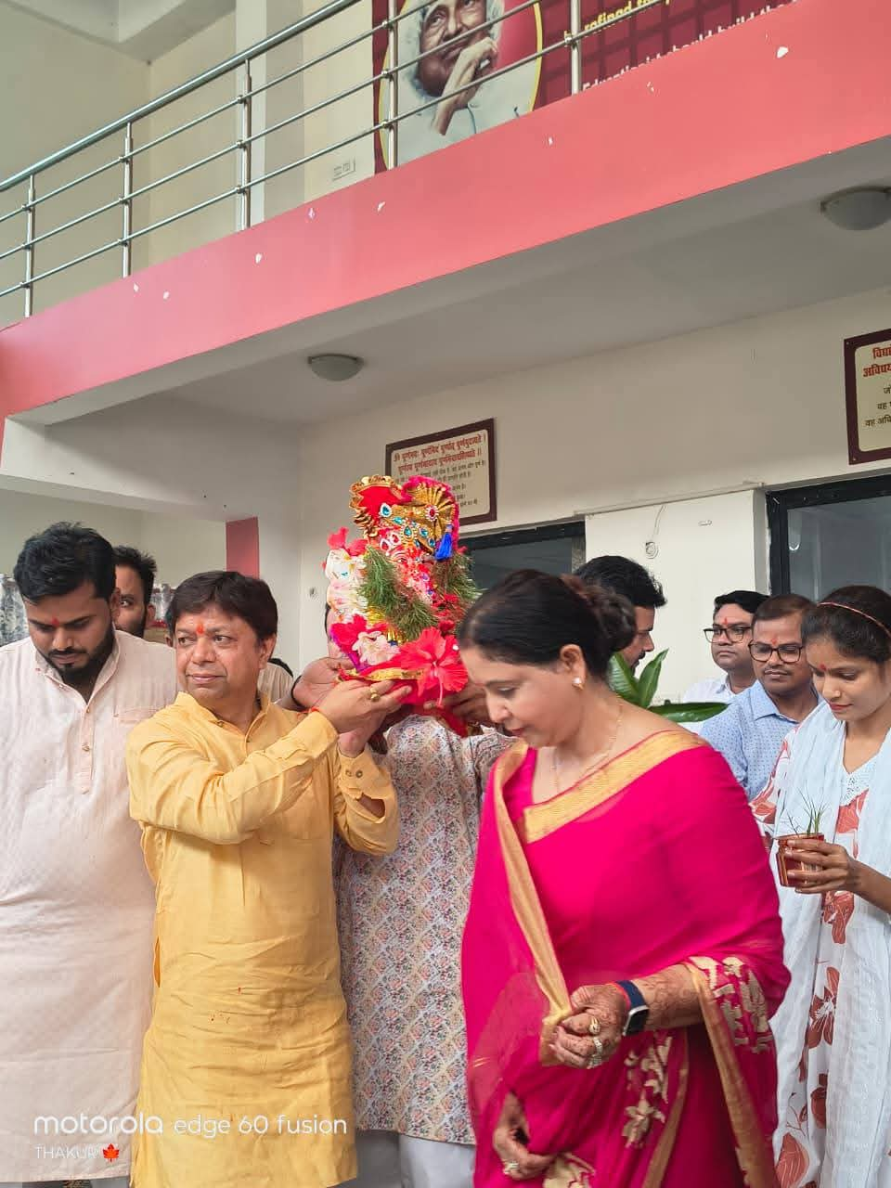
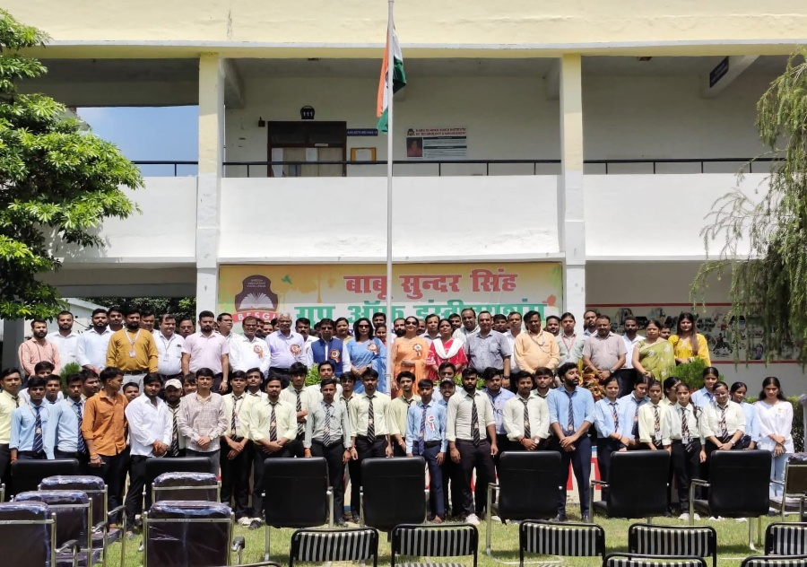
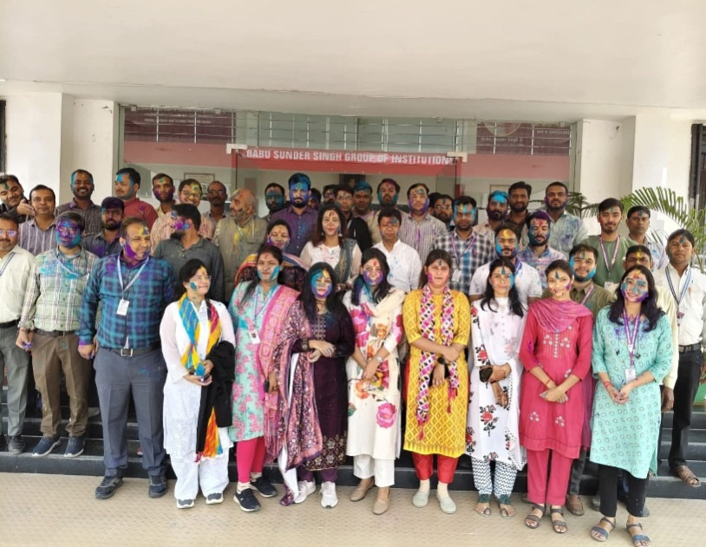
Celebrations

Slide 22
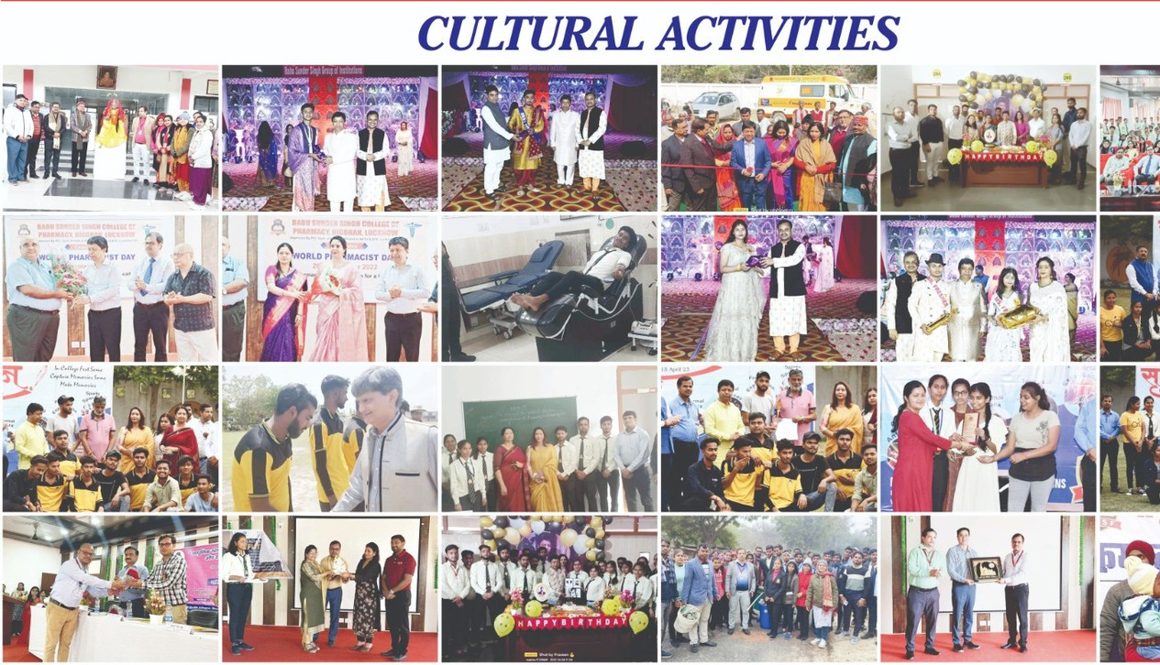
Departmental Cultural Activities

Slide 23
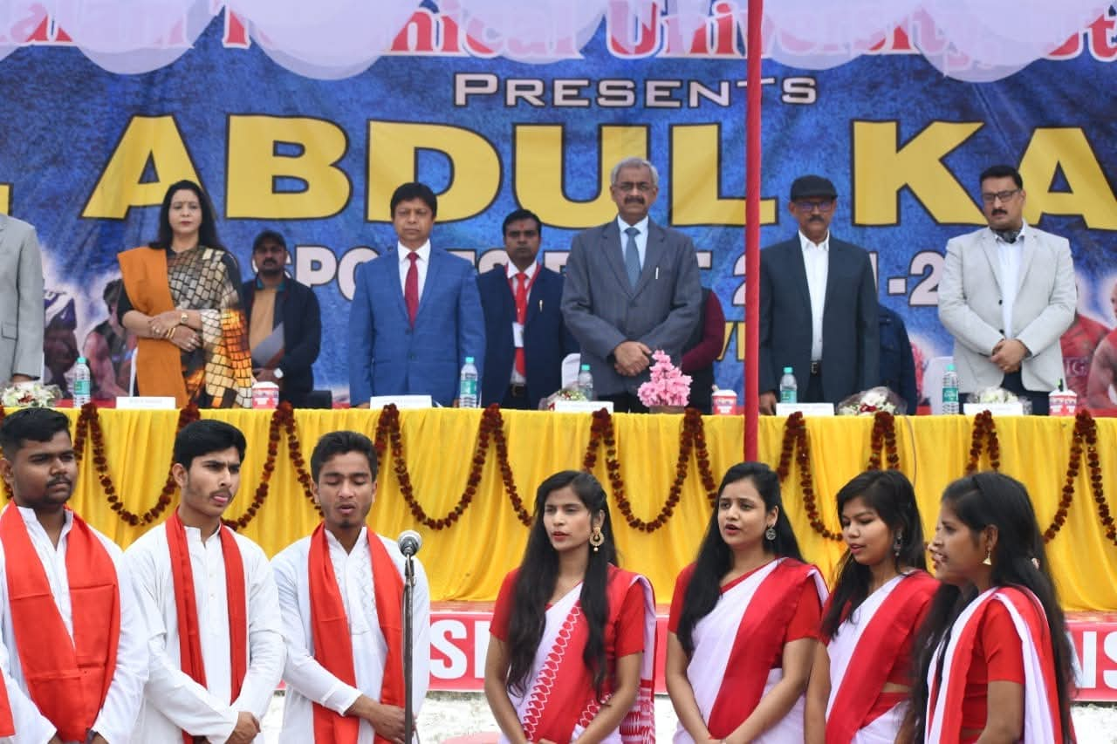
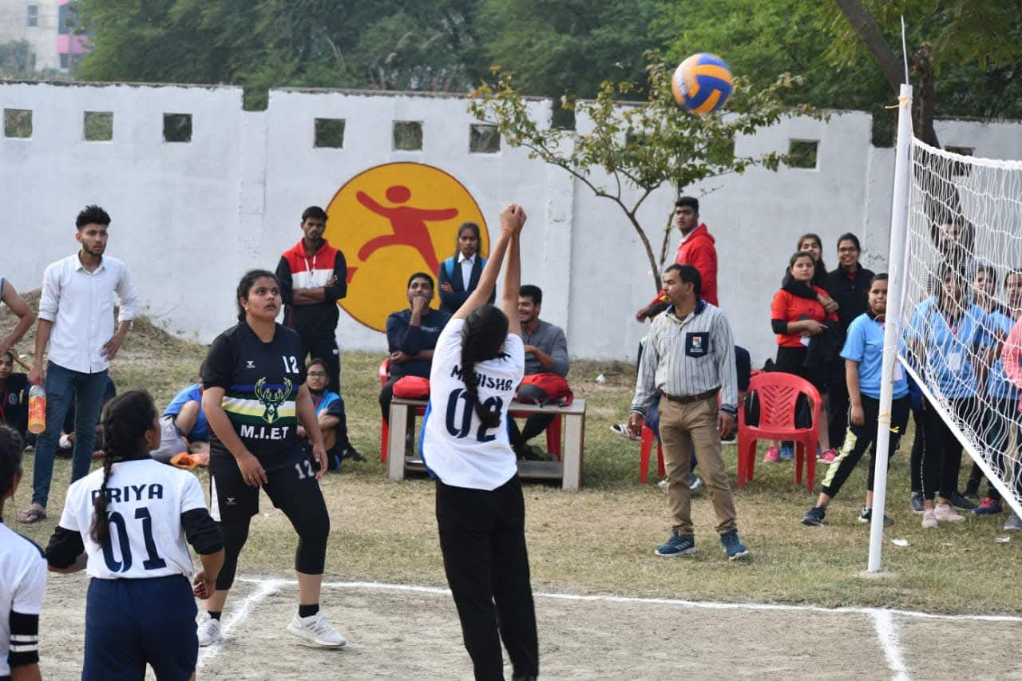
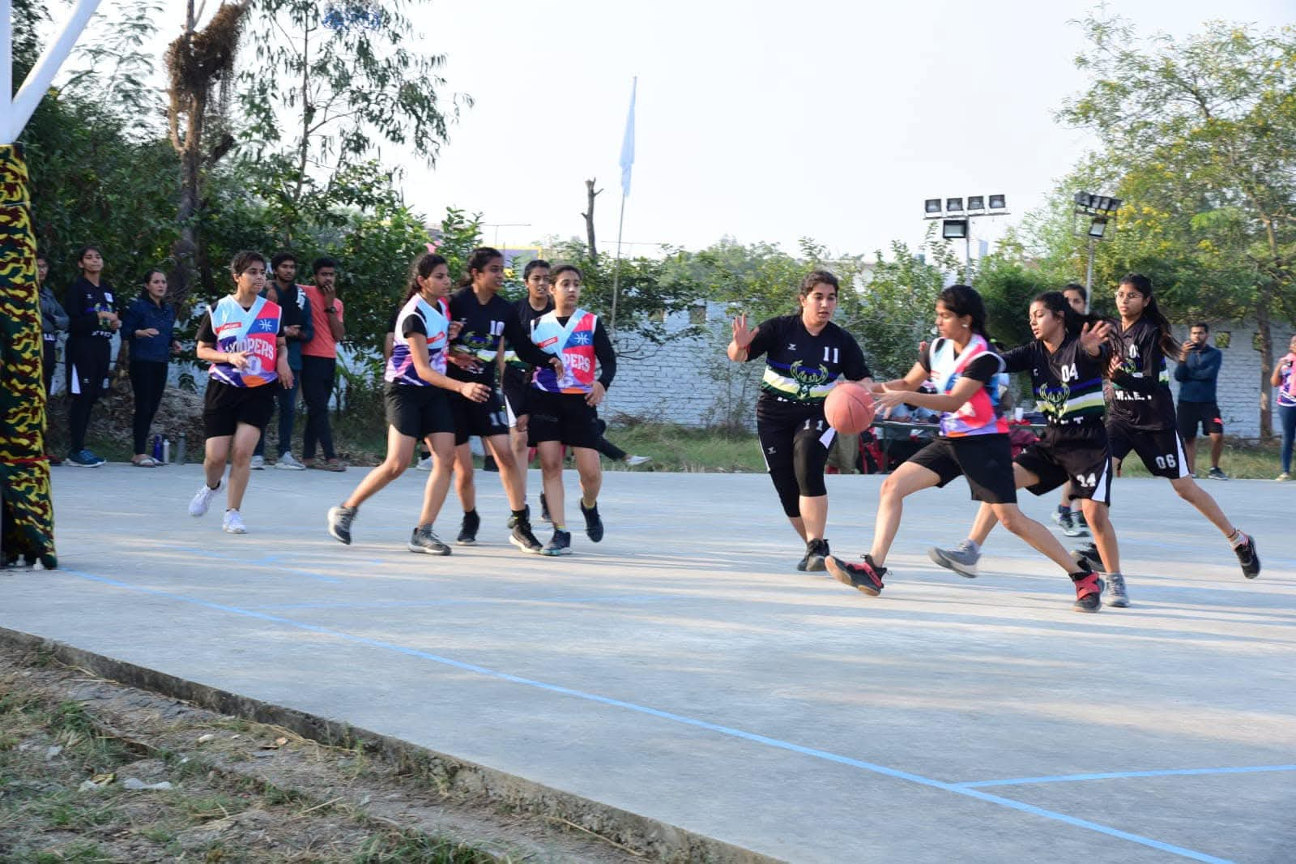
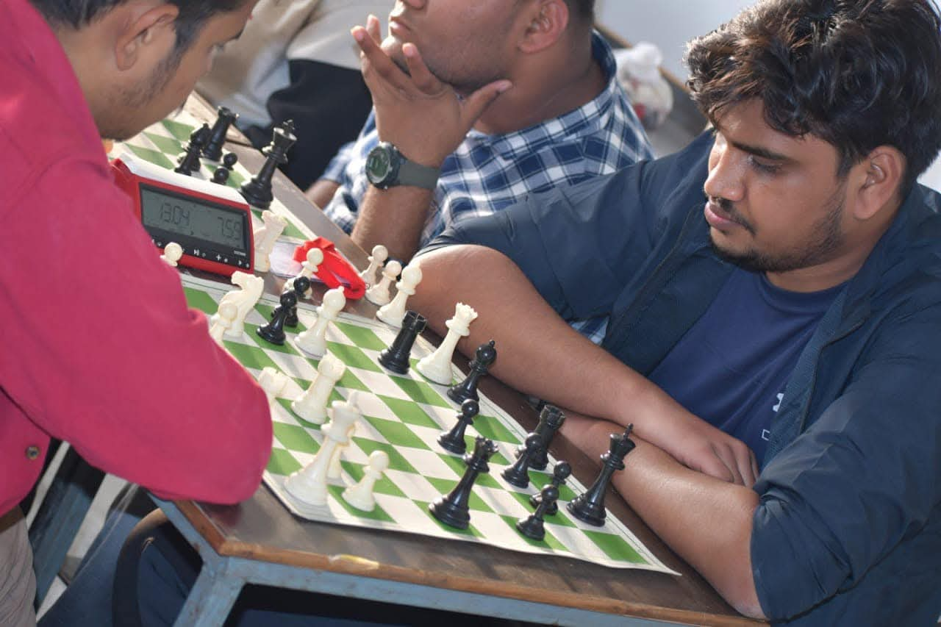
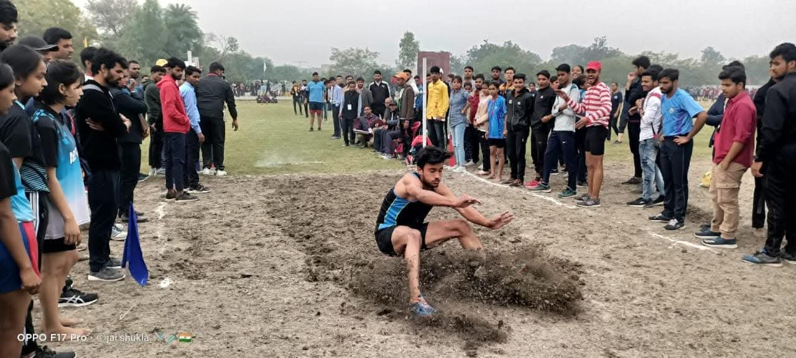
Sports

Slide 24
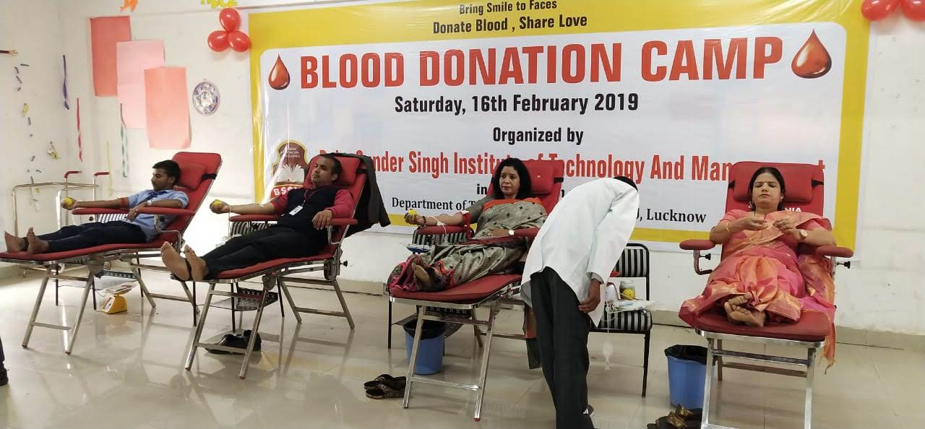
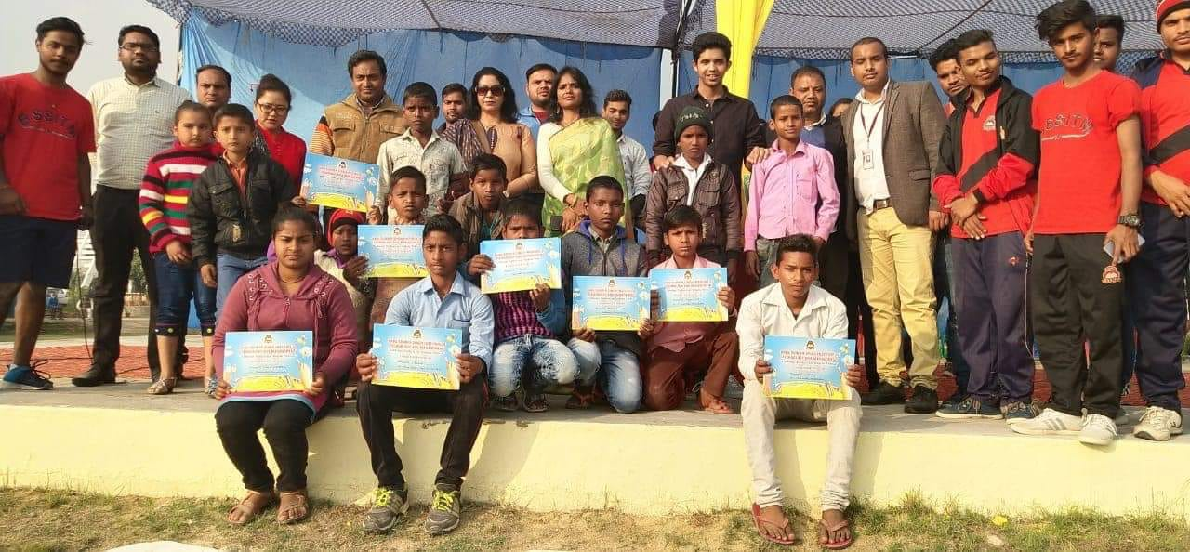
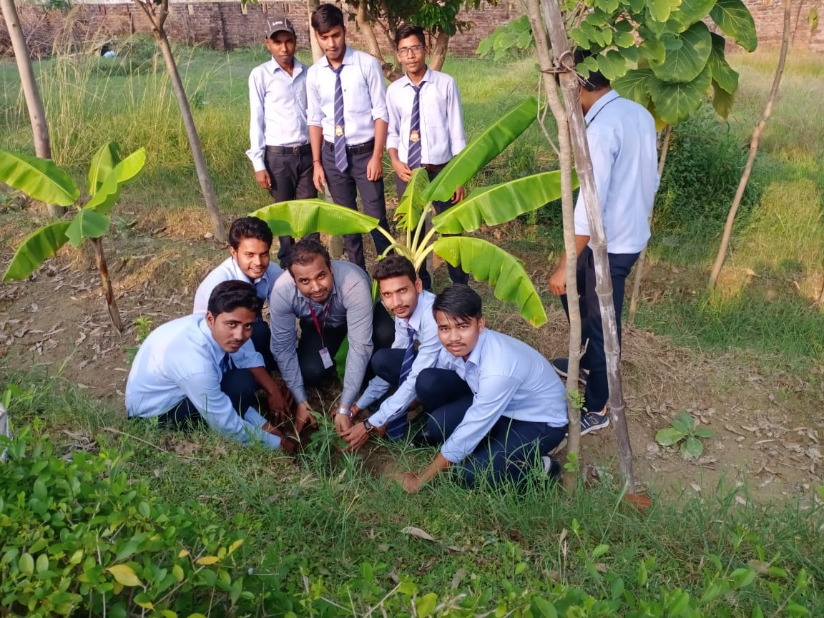
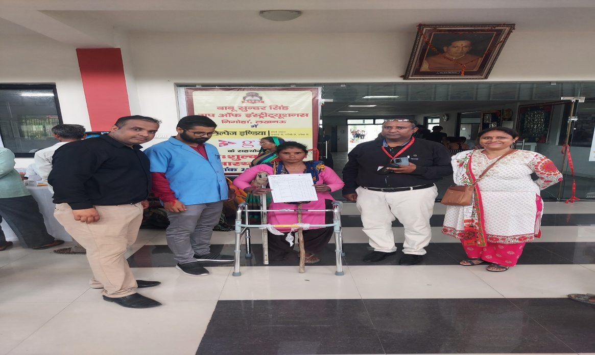
FEW SOCIAL RESPONSIBLE ACTIVITIES
Department and students had active participation in the Swacch Bharat, Unnat Bharat, Social Awareness Programme such as Padhenge Padhayenge Shiksha Abhiyan, Blood donation Camp,Voting Awareness programme, Solid Waste Management, Helping to old age citizens etc.

Slide 25
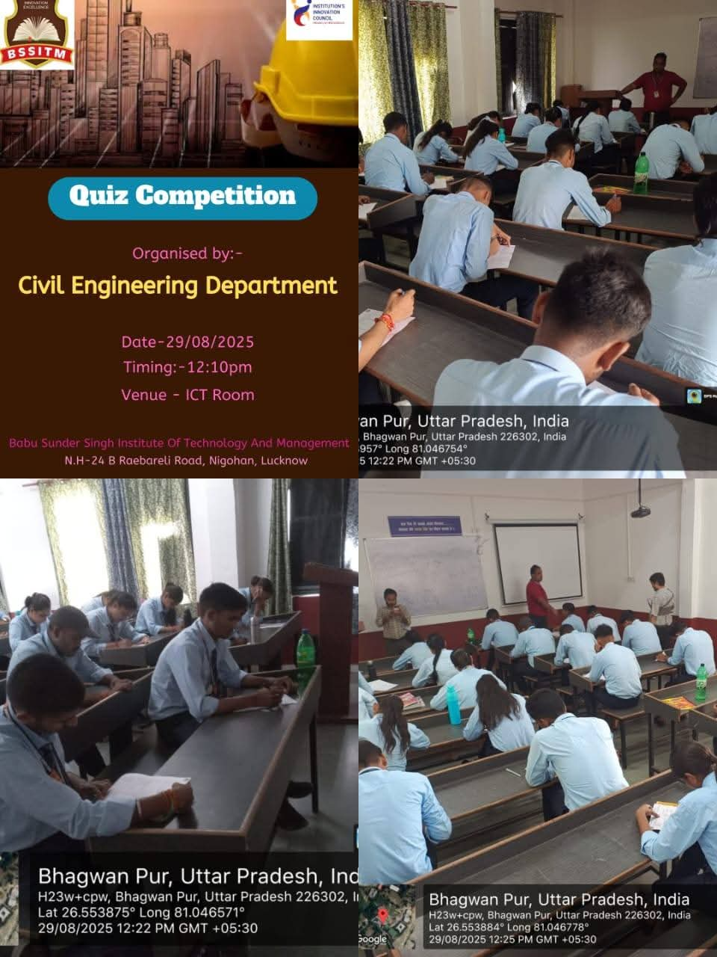
STUDENTS ACTIVITIES (Curricular)

Slide 26
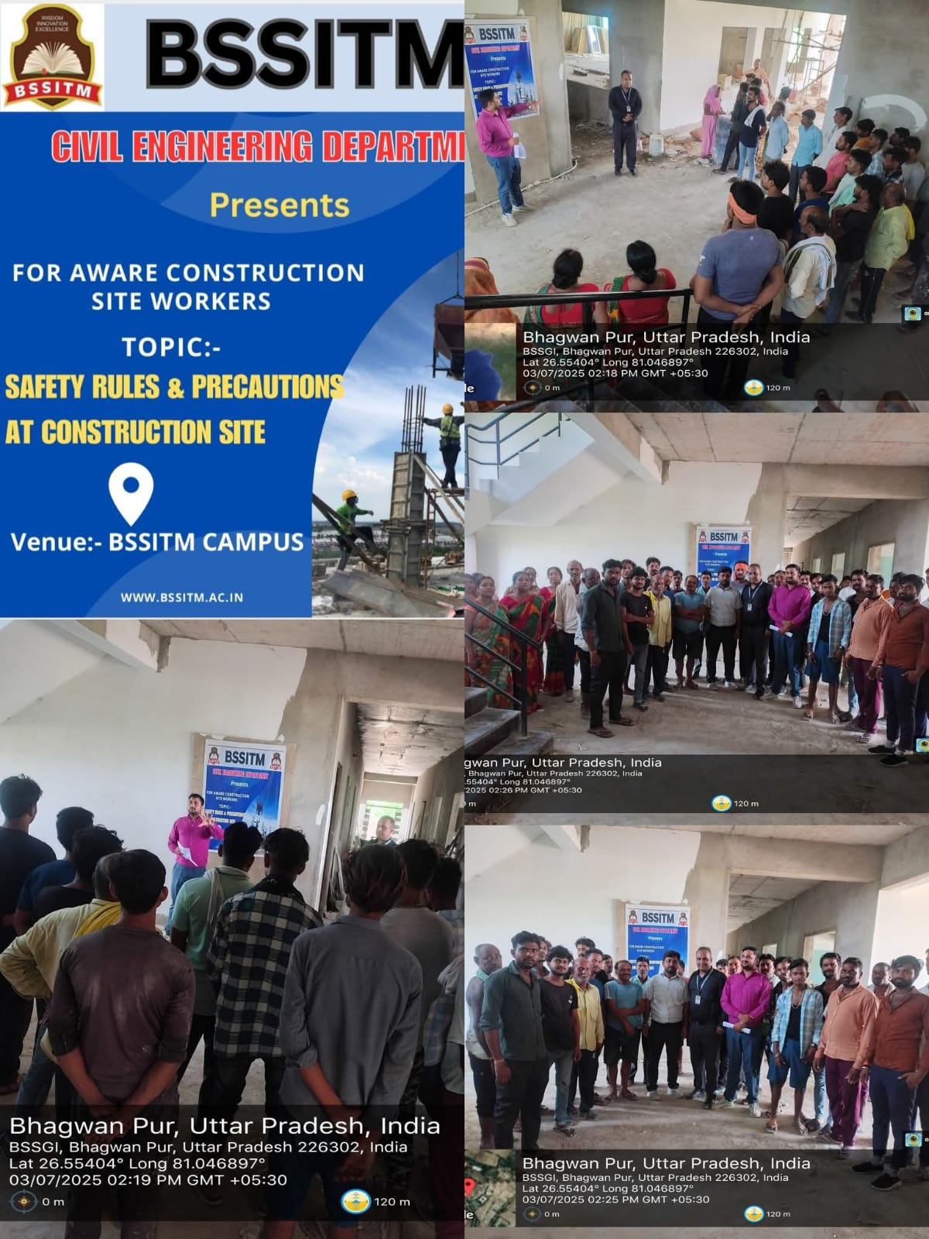
ON-SITE SAFETY AWARENESS
PROGRAM

Slide 27











Major Recruiters
College provides continuous placement activities in industry through placement department of BSSITM. Rigorous Soft and technical skill enhancement of student is carried out by the school before placement drive. List of recruiters are as follows.

Slide 28
Career Opportunities after B. Tech (Civil Engineering)
Public Sector (PSE/PSU)
Higher Studies (M.Tech / MS /MBA)
Private Sector Jobs & Entrepreneur
Structural Engineering
Construction Engineering and Management
Environmental Engineering
Geotechnical Engineering
Water Resources Engineering
Infrastructure Engineering
Transportation Engineering
Ocean Engineering
Remote Sensing &
Management Studies
Planning Engineer
Site Engineer
Quantity Surveyor
Design Engineer
Cost & Estimation Engineer
Drafting Engineer
Project Engineer
Building Valuator &
Own Company start ups
Public Work Department (Central & State)
Railways & Airport
Water Resources
Military Engineering Services
RITES
SAIL
BHEL
ONGC
HAL
NTPC & NHPC
IOCL & HPCL

Slide 29
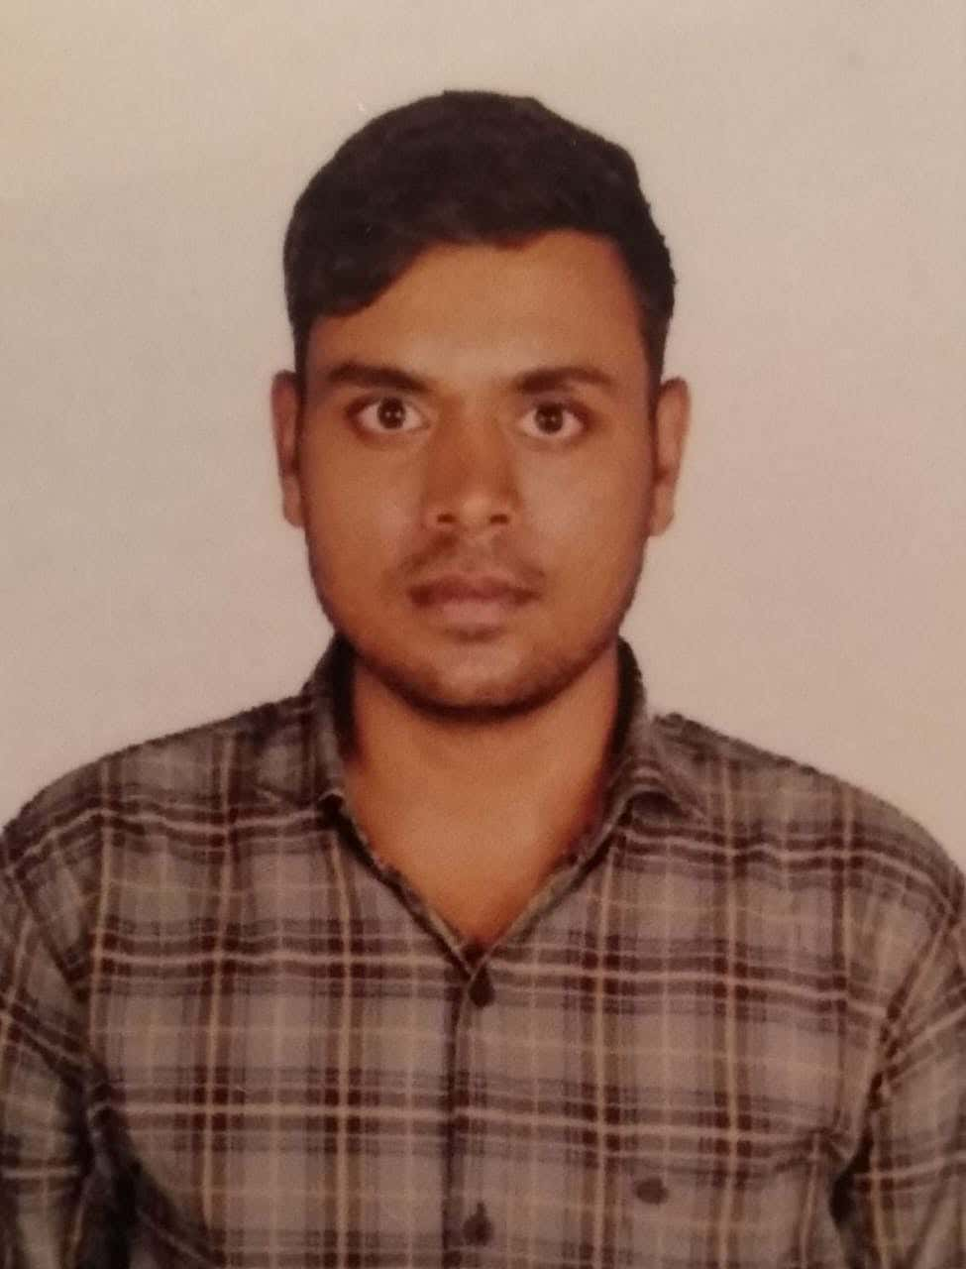
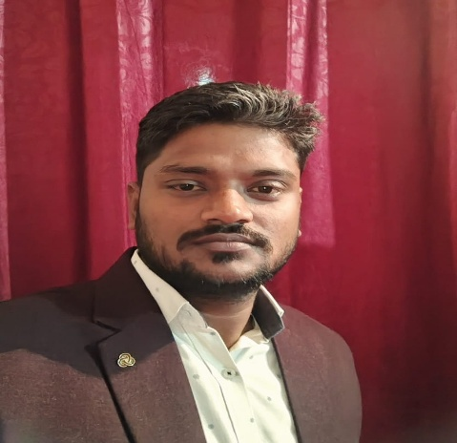
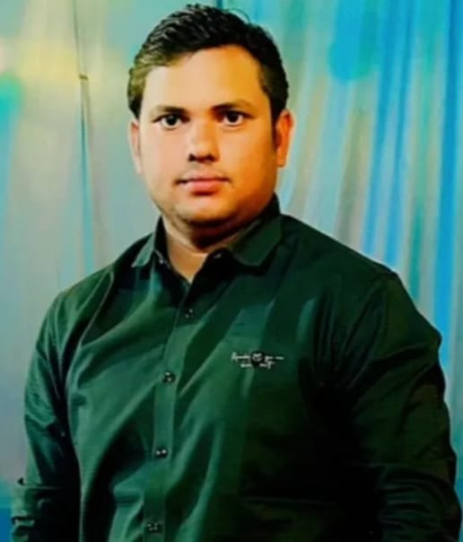
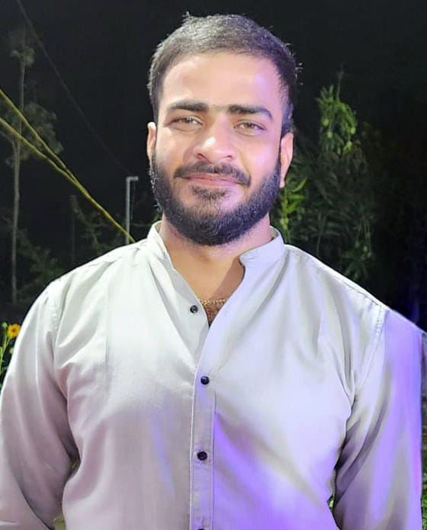
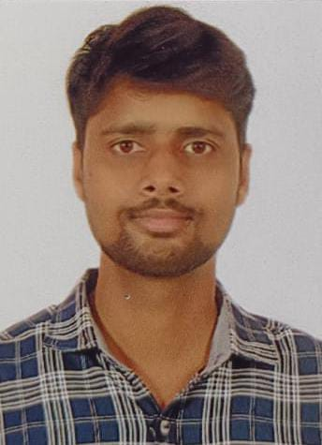
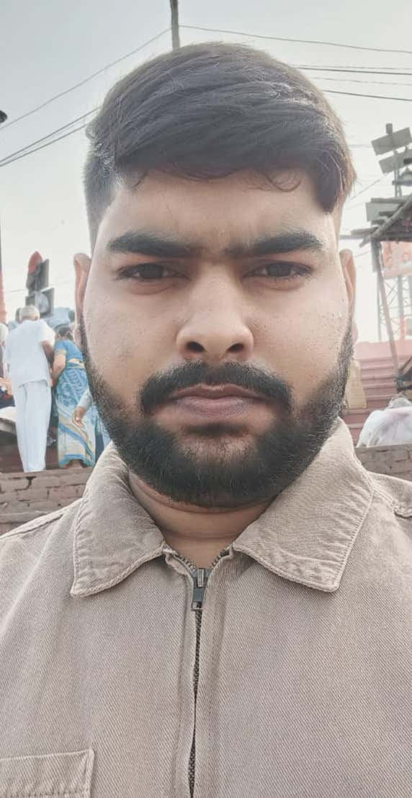

OUR PRIDE…
Altaf Raja
Zamil Construction India Pvt. Ltd.
Package- 6 LPA
Shailesh Chaurasiya
RPP Infra Project Ltd.
Package- 4.8 LPA
Amit Singh
MAA VAISHNOO INFRA VENTURE PRIVATE LIMITED
Package- 4.8 LPA
Manish Singh
Chahr Infra Construction Private Limited, Lucknow
Package- 4.5 LPA
Satish Tiwari
PRA India Pvt. Ltd.
Package- 4.2 LPA
Krishna Datta Singh
Transrail Lighting Limited
Package- 3.84 LPA

Slide 30








Babu Sunder Singh Institute of Technology & Management, Lucknow
Heartiest
Congratulations
On the successful placement of the students of Civil Engineering Department
In
CORRTECH INTERNATIONAL PVT. LTD
Package-3 LPA
Deepak Maurya
Raj Mishra
Abhishek Dwivedi
Shubham Raj
Aditya Kumar
Kunal Srivastava
Harshit Goswami
Praveen Mishra

Slide 31

BABU SUNDER SINGH GROUP OF INSTITUTIONS
B.Tech in Civil Engineering with Minor Degree
We Offer Dual Degree Program

Slide 32




BABU SUNDER SINGH GROUP OF INSTITUTIONS
OUR EDUCATIONAL INSTITUTIONS
Babu Sunder Singh Institute of Technology and Management
Babu Sunder Singh College of Pharmacy
Babu Sunder Singh Degree College

Slide 33




BABU SUNDER SINGH GROUP OF INSTITUTIONS
Collaborations and Partnerships
MoU signing between BSSITM, Lucknow, and Limkokwing University of Creative Technology, Cyberjaya, Malaysia.
The MOU signing between Nizhny Novgorod State Pedagogical University (Russia) and BSSGI, marking a new chapter of academic collaboration, student exchange, and joint research initiatives.
We also Collaboration with other academic institutions, training institute and research bodies.

Slide 34
Courses Offered
BABU SUNDER SINGH GROUP OF INSTITUTIONS
BSSITM
B.Tech(AG, AI & ML,CE,CSE,EC,EE,
IT & ME)
M. Tech(CS & EC)
Diploma(CE,CS,EE& ME)
BSSCOP
B. Pharm
D. Pharm
M. Pharm*
BSSDC
BCA
BBA
B. COM
MBA*

Slide 35
BABU SUNDER SINGH GROUP OF INSTITUTIONS
Thank You for Choosing Us!
We truly appreciate your time and interest. At BSSGI, we are dedicated to delivering the highest quality to meet your needs and exceed your expectations. Your trust in us is invaluable, and we are excited to be part of your journey.
If you have any questions or need further assistance, don't hesitate to reach out. We're here to help!
Contact Us:
Website: www.bssitm.ac.in
Email:
bssitmlucknow@yahoo.com, bssitmhodce@gmail.com
Phone: +91-7607006030
Address:
Babu Sunder Singh Group of Institutions NH - 24b, Raebareli Road, Nigohan, Lucknow, Uttar Pradesh 227309

